Slide 1
Higher Education in Libya: Challenges and Future Plans
Mustafa M. Elfakhri
Professor of Biochemistry
Faculty of Medicine
University of Benghazi – Libya

Slide 2
Acknowledgment
First, I would like to express my deepest thanks to the organizing committee for inviting me to participate in such an important event. They offered me a formidable opportunity to address a very distinctive audience like yourselves.
Furthermore, I am grateful to several people for helping, in one way or other, with the building up of this presentation.
To all of those goes my sincere appreciation .

Slide 3
Making use of my humble experience as an educationist, augmented with my profession as a Clinical Biochemist, I am aiming in this presentation to :
Describe, evaluate and properly diagnose the syndrome of performance decline of the Libyan higher educational system .
Discuss the etiology of the apparently observed symptoms.
Prescribe specific requirements and recommendations , to be shared with others of different specialities in a way that might enlighten our future perspective to :
Ameliorate this unhealthy condition.
Adopt effective means for achieving good prognosis .
Design a proper rehabilitation scheme .

Slide 4
Layout of the Presentation
Objectives
Introduction
Challenges facing higher education in Libya
Requirements
Recommendations

Slide 5
Objectives
Show importance of Educational system
Summarize Challenges of Higher Education in Libya
Design
an action plan towards development
Present
a strategic plan outline model
I
II
III
IV
5

Slide 6
Introduction

Slide 7
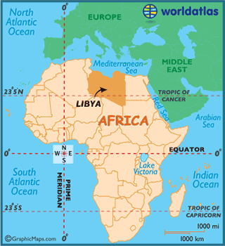
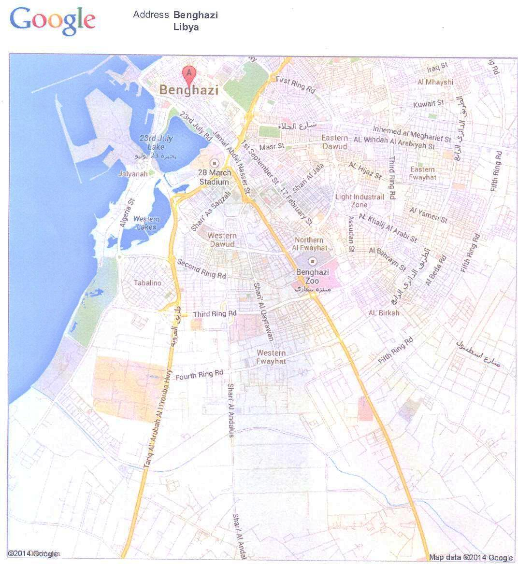
Geographic location of Libya, Benghazi , LIMU & UOB
LIMU
UOB
Tripoli
7

Slide 8
No doubt, educational institutions are the principle pillars for establishment of sustainable human development which leads to community progress.

Slide 9
Therefore, it is essentially important to develop their infrastructure, programs, financial resources and assure the quality of their outcome to effectively respond and fulfill community needs.

Slide 10
The contemporary world is experiencing an unprecedented scientific advancement in all aspects of life . It is becoming a formidable task to stay internationally competent. Improving educational programs to well prepare our young generation is the key to do so .

Slide 11
The future requirements of education is choosing quality over quantity and adopting modern, reliable teaching methods in order to acquire knowledge, develop skills and attitudes that comply with good professional practice to meet the challenge of globalization.

Slide 12
Education in Libya is free for everyone from elementary school up to university level.
Libya’s population (2010) of approximately 6.17 million includes:
1.7 million students (28% of population), over 300,000 of whom study at tertiary level, including those in the higher technical and vocational sector (≤ 10%)
This number of students represents an increase of over 290,000 since 1975, when just over 5,000 students were enrolled.

Slide 13
The general decline in the quality of Libyan higher educational system within the last 3 decades is well recognized.
The efficiency of its product has been proven to be inconsistent with the national economical and developmental needs.
Ref:
*Proceeding , Conference of Public Policies , Benghazi 12-14/06/2007
Supervised by Research and Consulting Centre – university of Benghazi (Previously Garyounis)

Slide 14
Absence of strategies
Poor performance of Pre-University educational institutions
Excessive number of students admission
Negligence of Technical Education
Irrational expansion of higher educational institutions
Poor infrastructure of higher educational institutions
Legislative & administrative defects
Poor performance of academic staff members
Outdated curricula & teaching methods
Weak financial income and disbursement procedures
Poor investment in education
Poor postgraduate & research programs
Challenges

Slide 15
I tried here to concentrate on the internal challenges arised from components of the higher educational system in Libya that affecting its own performance .
This does not under estimate the effect of other external threats , but they just remain beyond the scope of this presentation.

Slide 16
Requirements

Slide 17
Lack of a national strategic plan (1,2,3,4,5)
Like all other sectors, the higher education in Libya needs to build up its own strategic plan.
It has to be effective and constructed with clear achievable and measurable objectives, with attention in making priorities.
Designed by all stakeholders.
Considering local factors and international standards.

Slide 18
Poor primary and secondary school output (4.6.10)
Nurseries, primary and secondary schools are the prime factor in establishing students mentality, character and ability to learn.
Fostering quality of this pre-university stage will improve the higher educational input.
Improvement should encompass curricular development , adopting active learning strategy with emphasis on the quality of teacher, incorporating foreign languages, social education and information technology.

Slide 19
Comparison of pre-university teaching hrs in Libyan Educational system with others
 | Teaching hrs/ day | Total teaching days | Total teaching hrs
Libya | 5 | 148 | 740
South Korea | 13 | 220 | 2860
Malaysia | 10 | 210 | 2100
Singapore | 11.5 | 200 | 2300
Ref:
* Dr Aref Elteer- Development of human resources in Libya (Malaysia as a model) Nov. 2013 – Ministry of Education
website.

Slide 20
Excessive Students’ Admission (2,4,6,7)
In a young nation like Libya where 63% of its population is below 40 years of age, the need for more investments in education is unavoidable.
Free education policy and hence increasing demands magnified the burden on higher education institutions.
Poor quality of university input and annual increment of students’ number have a negative effect on the performance of universities.

Slide 21
316000
301000
223000
2000

Slide 22
This poor uni. performance has a two-fold negative impact;
Expenditure on a poor quality higher education.
Employment of a large number of incompetent graduates.
If no enough and suitable jobs were created, unemployment rate of such young generation would critically rise.
Therefore, a better selection criteria for student admission are needed which are consistent with institution capacity and market demands.
More incentives and attractions should be adopted to promote technical and vocational education.

Slide 23
Structural Problems (5,6)
Irrational horizontal expansion of higher educational institutions with no diversity or identity, and the absence of basic foundation requirements led to poor university performance and hence incompetent graduates.
The apparent lack of coordination between programs specifications and the local market needs is a well observed fact.
Therefore, institutional reform is urgently needed.

Slide 24
Horizontal Expansion in Numbers of Higher Educational Institutions in Libya Compared to Malaysia &International Reference Standards (IRS)
 | Libya (population of 5 million approx. ) |  |  | Malaysia (30 million population approx.) | IRS
Year | 1970 | 1995 | 2004 | 2000
Universities | 1 | 12 | 67 1 Uni. per 0.075 million inhab. | 50 1 Uni. per 0.6 million inhab. | 1 Uni. per million inhab. Cost effectiveness. Threshold analysis.
Higher Technical Institutions | 4 | 54 | 120 | 415
Ref:
*Proceeding , Conference of Public Policies , Benghazi 12-14/06/2007
Supervised by Research and Consulting centre – university of Benghazi (previously Garyounis)
* Dr Aref Elteer- Development of human resources in Libya (Malaysia as a model) Nov. 2013 – Ministry of Education
website.

Slide 25
Poor Infrastructure (8)
Lack of investments, limited capacity, increasing demands and absence of planning resulting in a deformed institutions with poor infrastructure.
Inefficient flabby administration with the absence of quality management system and under developed information technology aggravate the problem .
Development of university infrastructure is a prerequisite requirement that involve the build up of quality assurance system & application of relevant IT programs to enhance academic and administrative processes.

Slide 26
Administrative and Legal Problems (6)
Long lasting state control
Political & security intervention
Lack of autonomy of higher educational institutions
Chaos of university management
Ineffective legislations & loss of university traditions
Gaining more autonomy of higher educational institutions is a mandatory requirement.

Slide 27
Poor Academic Staff Performance (5,8)
• Irrational expansion of universities
Shortage in staff
Encouraged academicians for more part time jobs
Overloaded commitments
• Ineffective legislations & loss of university traditions
Compromised criteria for staff recruitments
Decline of responsible and professional commitment of teaching staff in addition to altered ethical values
Filtration & continual professional development programs for staff members should be conducted with adoption of strong effective +ve & -ve incentives to ensure good implementation & commitment.

Slide 28
Outdated curricular and Teaching Methods (6.11)
Similarity of programs offered by most universities.
Prevailing of rot learning teaching methods, lack of science integration, depending on factual knowledge and giving no attention to professional skills & social education.
“The change is a must”
That should include curricular development to meet good professional practice.
As well as, the concept of student centred education is ought to be introduced.

Slide 29
Poor Financial Resources (6,9.12)
The problem of educational under funding
( ≤ 3.5% of GDP)
Instability of funds
Lack of autonomy (complete dependency on government funding)
All of these caused impossible execution of plans to cover the expenses of the increasing number of students
Diversification of financial resources in order to secure sufficient & continuous funds .

Slide 30
Poor Research and Postgraduate Programs (6.13)
Scarcity of funding & lack of defined research priorities.
Postgraduate and research programs should possess clear goals and strategies consistent with national priorities & interest such as:
Sustainable human development.
Solving local problems
Building economy.
Fostering knowledge economy
Raising standards of living.
Collaboration of mutual benefit with other service providers.

Slide 31
Recommendations

Slide 32
Adopting a national strategy for higher education aiming to :
Improve process management .
Attain better quality of graduates .
Foster international competitiveness.
In doing so, we need to :
Analyze the existing system to draw national goals to be implemented in the strategy.
Involve all stakeholders in the strategy building.
Insure enough resources , means to deliver , elements of control & follow up, and the existence of stable effective administration.
Raise public awareness of the strategy to ensure a broad participation.

Slide 33
Linking educational programs to local, national and international market needs through:
Setting a national reference standards (NARS) for higher educational programs consistent with international standards and national identity and needs.
NARS should represents the minimal requirements of knowledge and skills the graduate should be equipped with in either the private or public sectors.
Allowing universities to have their own ARS which may surpass NARS.
Ensuring the concepts of life long learning, active learning strategies and community based education.

Slide 34
Promote investment in education
Aiming to enforce quality assurance system & achieve the competitive benefits of globalization through:
Collaboration with international bodies: Inviting international Universities to establish their branches in Libya.
Signing MOU with international Universities regarding postgraduate studies : Adopting Channel System with joint supervision programs.
Establishment of a student loan system and scholarships for gifted students or for specialties with most national interest.

Slide 35
Calculate actual cost of each academic program
Invite accredited International and National Universities (state & private) to offer places according to a competitive scheme
Invite Baccalaureate students to apply
Government offers non - profit loans to cover tuition fees of admitted students

Slide 36
Student loans are reimbursed ( partially or totally ) based on well selected criteria through comfortable premiums after graduation and employment.

Slide 37
The aim of this proposal is to ensure :
Achievement of national priorities .
Student competitiveness .
Seriousness and capacity of student to pursue higher education.
Student independency .
Rational funding .
The right of future generations in the national resources.

Slide 38
Benefits
Reduce load on public sector
Improve infrastructure of educational institutions
Global competition
Accommodate market needs
Attainability of social justice
rational use & recycling of fund
Encourage private sector in education

Slide 39
Conclusion
Presumably, the content of this presentation disseminated a distressful feeling among you. It seems to be like a blunt dissection into the system of higher education in Libya. As a matter of fact, it is an attempt to deeply expose the origin of illness in this system, as an initial preoperative phase to prepare it for a delicate major surgical correction.
Indeed, such treatment is not a pain-free procedure and it might apparently irritate our national pride. But, it is a well known fact, the first step in strategic planning is to know where you exactly stand in order to decide where to go and how to reach there.
This is truly my intention , so may God help us all.

Slide 40
المراجع References -
د. مصطفى عمر التير (2004) ندوة التعليم العالى والتنمية فى ليبيا – طرابلس .
د. عبد النبي ابو غنية (2004) ندوة التعليم والسياسات التعليمية فى ليبيا – طرابلس .
د.محمد على الأعور (2006) ندوة التعليم العالى والتنمية فى ليبيا – طرابلس .
د. محمد موسى العبيدى (2007) الأثار المترتبة على السياسات الموجهه لنظام التعليم فى ليبيا ( أبحاث مؤتمر السياسات العامة – بنغازى )
د. سعد محمد الزليتني (2007) التخطيط للتعليم العالى فى ليبيا ( أبحاث مؤتمر السياسات العامة – بنغازى ) .
د. عبدالرحيم محمد البدرى (2007) بعض مشكلات سياسات التعليم العالى فى ليبيا ( أبحاث مؤتمر السياسات العامة – بنغازى ).
تقرير المجلس الاستشاري العالمي برئاسة د . مايكل بورتر (2006) تقييم التنافسية فى ليبيا .
د. محمد صبحي قنوص و سليمان محمد الجروشي (2004) تقرير حول وضع الجامعات والمعاهد العليا فى ليبيا (لم ينشر ) .
د. عيسى بغنى (2012) قراءة فى تقرير التنمية البشرية لسنة 2011 – نشر على الموقع الالكترونى " ليبيا المستقبل " بتاريخ 31-1-2012
د. عبد السلام القلالي «مندوب ليبيا لدى اليونيسكو- (2012) المنظومة التعليمية في ليبيا – ورقة مقدمة الى المؤتمر الوطني للتعليم – طرابلس بتاريخ 15-17 /9 /2012
تقرير عن واقع التعليم في ليبيا وافاق المستقبل (2013) – المركز الوطني لدعم القرار – رئاسة مجلس الوزراء – www.npdc.gov.ly
د. عبدالله المقيرحي (2012) احتضار التعليم في ليبيا ، اسبابه وسبل الاصلاح – جريدة الوطن الليبية بتاريخ 5/9/2012
د. عبد الله المقيرحي (2012) نواقيس الخطر – جريدة الوطن الليبية بتاريخ 31/5/2012

Slide 41
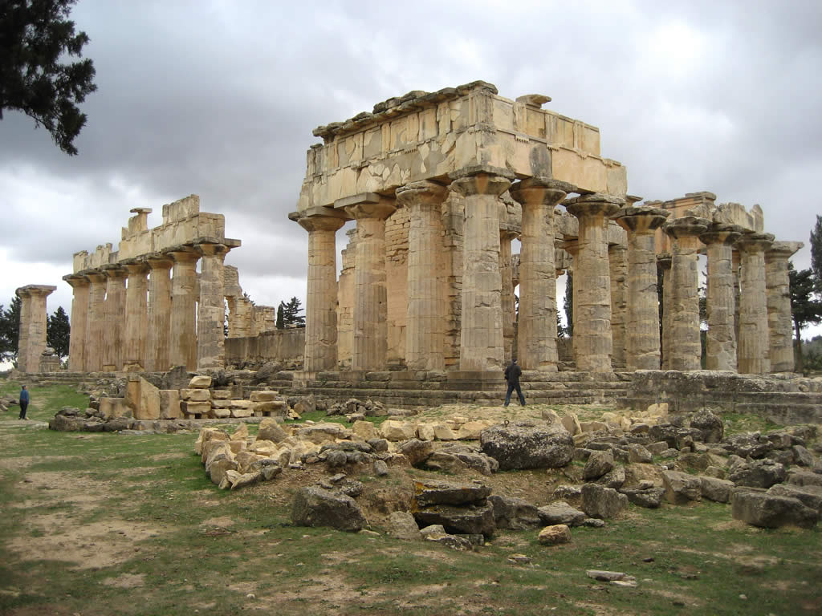
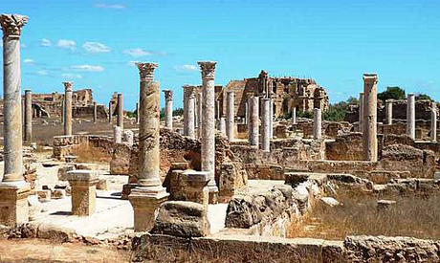
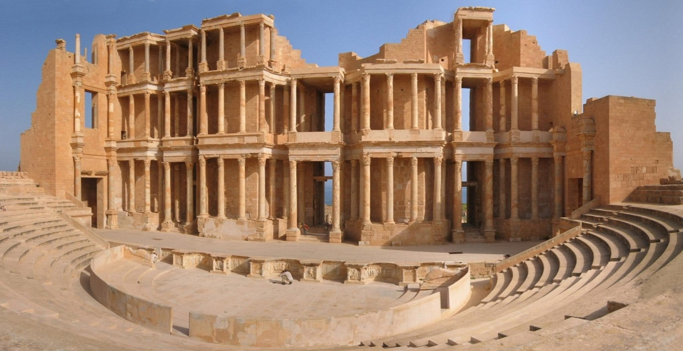
Thank you

